Slide 1
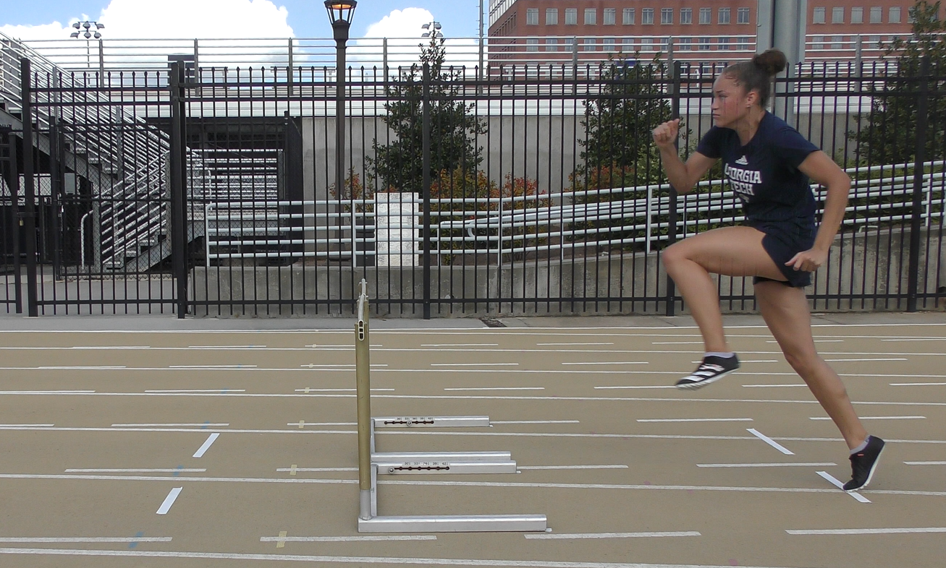
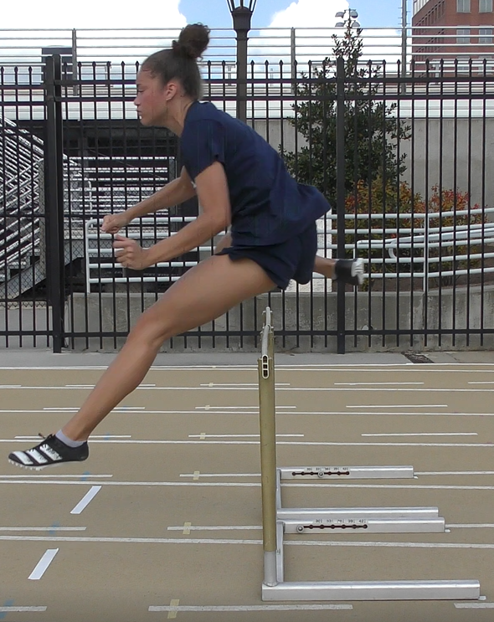
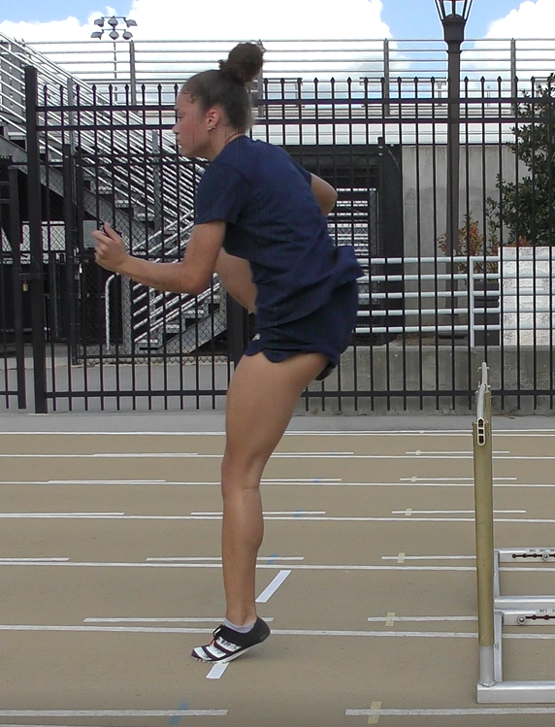
Total Distance – 8’9-1/2”
Take off point to hurdle base – 6’3-1/2”
Hurdle base leg 26”
Hurdle base to touch down after hurdle 30”
The height of the hurdle, from to top is 30”
Questions:
Is camera height best? Center on hurdle or top of hurdle? More accurate measurements (depth distorts?)
Clearance measurement possible without sensor?
Video does NOT catch ALL segments. Good enough? TBD
5
1
2
4
Center line
3
Not proportional do to depth. Can srink to fit.
6”?
30”?
30”

